Slide 1
Transfer Journey
Mapping Ghent
and impact measurement
Liat Rogel, Service Designer, Urbact Expert

Slide 2
Transfer Journey Mapping
Phases in time
ACTIONS
Starting Point
Stakeholders
End Point
Indicators

Slide 3
Transfer Journey Mapping - Starting Point (Template)
In the box below, please provide a short description of:
-why you joined the transfer network to start with
-what were your expectations
1. Evaluation
Ghent
We joined the transfer network because...
After Urbact program REFILL, we wanted to
provide simple and facilitating legal frameworks
Foresee an innovative legal framework (a checklist) to support new initiatives in the best possible way
Work on a specific asset
2. Our expectations were...
- breaking through conflicting interests -
Strengthening citizens initiatives and and enhance sustainability
Enhance the new role of the city in reinforcing citizen initiatives
Notes:
End of REFILL, we had this asset in mind of the church.
2. “Conflicitng interests” → be more specific → to create more understanding/communication between city administration because we all have different goals between us

Slide 4
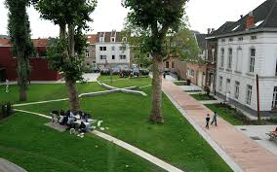
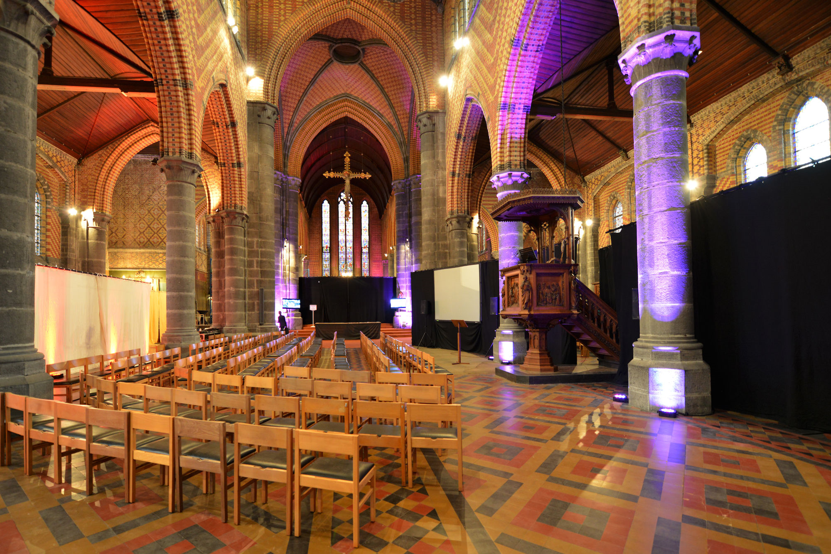
Transfer Journey Mapping - Starting Point (Template)
2. Assets
In the spaces below, please provide images of your STARTING asset(s) along with a short description (ex. Type of building, etc.).
Was not possible to work yet with the citizens
PLACE PICTURE(S) OF YOUR ASSETS HERE
PLACE PICTURE(S) OF YOUR ASSETS HERE
Change Picture
Tax regulation on the use of public space: exemption for citizen initiatives
St-Joseph church: open call for a manager
Notes:
We started with 2 pilots, but one of them (public parking lots throughout the city) could not be developed. The new policy of tax exemption for public spaces is a direct outcome that we think can be applied more widely to future public events. It’s a legal instrument that we consider a “mini-pilot” that perhaps has many other implications.
For St.Joseph church description → just one more phrase regarding the neighborhood that it’s in

Slide 5
Transfer Journey Mapping - Starting Point (Template)
In the box below, please provide a short description of your top 4 challenges.
3. Challenges
Challenge #1:
Challenge #2:
Challenge #3:
Challenge #4:
Not enough collaboration between the city services = need of a multidisciplinary team for citizen participation and public-civic collaborations/partnerships (LAWG). Complexity of the city administration in the relationship with commoners/civic innovators.
Not enough focus on long term = need to strengthen citizens initiatives and enhance their sustainability by supporting their growth, enabling them in order to ensure the long term impact etc
No tools to measure the social impact of citizen initiatives
Guaranteeing a higher level of openness and inclusiveness in citizen initiatives
Notes:
Good challenges

Slide 6
Transfer Journey Mapping - Starting Point (Template)
4. Policy
In the box below, please write a short description of your starting point in terms of policy.
Ghent has a long tradition in participative approaches. Policymakers integrate a bottom-up approach in planning and decision making processes. We have a policy participation service with 20 neighbourhood managers cho deliver tailored work to create more livable, more social and more sustainable districts. They are the go-between between various stakeholders. There is a deputy-mayor of Participation!
Commons?
Type an ‘X’ to indicate Yes or No
YES X
In the box to the right, briefly describe how innovative your policy was.
We have a fund of temporary Use of Vacant buildings, there is a group of different “commoners”, coming together a few times each year with support of the city - exchanging experiences etc.
NO
-
Citizen participation?
Type an ‘X’ to indicate Yes or No
YES X
In the box to the right, briefly describe how innovative your policy was.
We have a participation platform, a crowdfunding platform, there is a participatory budget, neighbourhood management projects, ...to enable and support citizens’ ideas and initiatives. Lots of experiments etc.
NO
-
Notes:
Clear. Add any links to past projects/names that would be relevant or interesting to include. Refer to legal briefs as well.

Slide 7
Transfer Journey Mapping - Starting Point (Template)
In the box below, please briefly describe how the ULG was first structured. Include references to the 5 types of stakeholders involved.
5. ULG
At first, we structured our ULG in a (1) city-wide ULG for the commons, cooperatives en civil initiatives and (2) a Neighbourhood ULG for our Pilot St-Joseph church.
City Wide ULG:
Public: Service of policy participation, legal service
Private: Not involved
Knowledge institutions: university of Ghent
Social Organisations: different not for profit organisations
Commonors/civic innovators: long list of participants active in domain of culture, energy, social, mobility, food, …
In the Neighbourhood ULG we have stakeholders in domain of youth, social, food, cultural, sports, youth and education.
Public: Service of policy participation, legal service, real estate service
Private: Not involved (yet) => local merchants will be involved
Knowledge institutions: university of Ghent
Social Organisations: different not for profit organisations: VZW Jong, Sociale Kruidenier, Toreke, ...
Commonors/civic innovators: local inhabitants from the neighbourhood Rabot are involved
Notes:
City-wide ULG comes from the REFILL program. A lot of commoners and civic innovators so they all have experience working together. The neighborhood ULG was this year and a smaller group discussing the St. Joseph church and we’re going back with the community manager to discuss the future of the church as a pilot

Slide 8
Transfer Journey Mapping - Starting Point (Template)
In the table below, please briefly describe how the 5 types of stakeholders were involved and their impact.
**TIP: Refer back to the previous files you created on this topic**
5. Neighbourhood ULG
Stakeholder Type | How was the stakeholder involved? | What was the impact/influence?
Public | Establishing contact between city services and organizing the ULG meetings | Creating the basis of the LAWG and the ULG, sharing knowledge about the project
Private | Not involved yet | -
Knowledge/ Institutions | Not involved yet | -
Social Organizations | Participating in ULG meetings | Sharing ideas about the collaboration between the city administration and commoners and about the pilot project(s)
Commoners/ Civic/ Innovators | Participating in ULG meetings | Sharing ideas about the collaboration between the city administration and commoners and about the pilot project(s)
Notes:
We want to involve the private local stakeholders once we launch the open call.
Knowledge institutions → They are involved city-wide and we are working with two professors, but we will include them in larger meetings and can always go to him for advice, but we don’t include in the smaller meetings. They are too busy to be directly involved in the ULG actively.

Slide 9
Transfer Journey Mapping - Starting Point (Template)
Mature
6. Objectives
In the box below, please briefly describe your starting objectives for the project.
Objective #1:
Objective #2:
Objective #3:
Objective #4:
Better coordination between city services & better communication with commoners etc.
Strengthen civic initiatives and enhance their sustainability
Develop a social impact tool
Inclusiveness: create solutions that guarantee a higher level of inclusiveness
Notes:
Objective 1 → could be more than one

Slide 10
Transfer Journey Mapping - Starting Point
Ghent
weak | Moderate | strong
 |  | x
 |  | x
 | x
 |  | x
 | x
Co-Gov
Enabling State
Soc&Econ Pooling
Experimentalism
Tech Justice
Notes:
No change

Slide 11
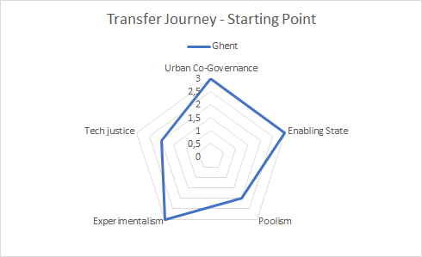

Slide 12
Transfer Journey Mapping - Actions
Phases/Time
Not all stakeholders acted at the same moment
Sometimes the same action happen together
Actions are of your ULG but main Transnational activities should be included
Think about the most relevant actions
You may add dots with specific moments you wish to highlight
Remember the specific CivicEstate timeline including transnational meetings, this may help you to remember better your own journey.
Public
What actions were made by this stakeholder?
What actions were made by this stakeholder?
1
Private
What actions were made by this stakeholder?
What actions were made by this stakeholder?
Knowledge institutions
What actions were made by this stakeholder?
What actions were made by this stakeholder?
Stakeholders
Social organizations
What actions were made by this stakeholder?
What actions were made by this stakeholder?
2
commoners/civic/
innovators
What actions were made by this stakeholder?
What actions were made by this stakeholder?

Slide 13
Transfer Journey Mapping
Starting Point (0-3 Months)
In the boxes below, briefly describe the actions done by each stakeholder during this phase, using just a few words.
Phases/Time (0-3 Months)
Public
Creating the basis of the LAWG by establishing links between city services. Creating the basis of the ULG by reaching out to the neighbourhood of the pilot project. Organizing the first meeting of the ULG. Sharing information on the project. Participation in ™ in Barcelona.
What actions were made by this stakeholder?
Private
Not involved yet
What actions were made by this stakeholder?
Knowledge institutions
Not involved yet
What actions were made by this stakeholder?
Stakeholders
Social organizations
Participating in ULG meetings and sharing ideas about the collaboration between the city administration and commoners and about the pilot project(s).
What actions were made by this stakeholder?
commoners/civic/
innovators
Participating in ULG meetings and sharing ideas about the collaboration between the city administration and commoners and about the pilot project(s).
What actions were made by this stakeholder?
00 - 03 Months
(Use if you have extra phases)
Notes:
First part OK

Slide 14
Transfer Journey Mapping
Transfer Learning Period to Transfer State Report (4-12 Months)
Transnational meeting in Ghent
In the boxes below, briefly describe the actions done by each stakeholder during this phase, using just a few words.
Had to rebuild political contacts
Phases/Time (4-12 Months)
Project leader leaves
Public
Organising LAWG and ULG meetings.
Organizing the Transnational Meeting in Ghent.
Creating an overview of the tools used in Ghent to organise the cooperation between the government and commons.
Writing the legal brief.
Organizing LAWG and ULG meetings.
Briefing hierarchie about the project. Finalizing the legal brief.
Writing the open call for the pilot project.
Participation in the ™ in Gdansk and Iasi.
What actions were made by this stakeholder?
Deputy Mayor joined part of the meeting
Private
Not involved yet
Not involved yet
What actions were made by this stakeholder?
Knowledge institutions
Actively participating to the Transnational Meeting in Ghent.
-
What actions were made by this stakeholder?
Stakeholders
Having the asset from the start, the stakeholder feel ownership , are collaborating
Social organizations
Give hugely valuable feedback in ULG.
Actively participating to the Transnational Meeting in Ghent.
Give hugely valuable feedback in ULG.
What actions were made by this stakeholder?
commoners/civic/
innovators
Give hugely valuable feedback in ULG. Ready to roll up their sleeves and go on the field!
Actively participating to the Transnational Meeting in Ghent.
Give hugely valuable feedback in ULG. Ready to roll up their sleeves and go on the field!
What actions were made by this stakeholder?
4 - 8 Months
9 - 12 Months
(Use if you have extra phases)
Notes:
Held the transnational meeting in Ghent, how was it? → it was a difficult moment because it was clear that Emma wasn’t going to be project organizer anymore but we still managed to do really well and include many interesting presentations and site visits.
How was it politically? → Emma was the one who was the contact with the vice mayor. Not sure if it really helped to push things, but the vice mayor was there and knows about the project. Previous mayor was also very interested in the project.
Commoners → they are enthusiastic about the pilot. So when you talk about St. Joseph church, they feel as if they are owners too. It’s not top-down and they are invested in finding a good manager themselves. Tip: it’s more helpful and concrete to start with a pilot asset. It’s also helpful to involve the neighborhood that it’s in, especially if the neighborhood is busy and doesn’t have much space available to do things in. There is a real need and people can quickly see the value of this shared space.
Involving the citizens also helps to outline things needed like a legal framework

Slide 15
In the boxes below, briefly describe the actions done by each stakeholder during this phase, using just a few words.
Transfer Journey Mapping
Learning Period and Training to Sharing (13-24 Months)
Phases/Time (13-24 Months)
Public
Organizing LAWG and ULG meetings.
Finalizing the open call for the pilot project.
Organizing LAWG meetings.
Participation in Urbact webinars.
Formulating local end goals for the project.
What actions were made by this stakeholder?
Private
Not involved yet.
Not involved yet
What actions were made by this stakeholder?
Knowledge institutions
-
-
What actions were made by this stakeholder?
Stakeholders
Social organizations
Give hugely valuable feedback in ULG.
Less contact due to Corona and holidays.
What actions were made by this stakeholder?
commoners/civic/
innovators
?Give hugely valuable feedback in ULG. Ready to roll up their sleeves and go on the field!
Less contact due to Corona and holidays.
What actions were made by this stakeholder?
13 - 16 Months
17 - 20 Months
(Use if you have extra phases)
Notes:
During co-vid, of course we weren’t thinking actively on the ULG and pilots. The budgets for all of the city were frozen, so we didn’t know if our original budget could stand or go on. Now the budget is fixed once again and we are now able to go on. We were able to discuss more of the legal issues, but we weren’t able to receive feedback from the commoners/citizens. We weren’t sure what we had to offer, so it was difficult to hold discussions with citizens.
But, we have a lot of ideas that are all connected to the civic eState project, but we need to create a list of ideas that we can execute at a later time. We want to make a kind of checklist for future ideas. We learned the 12 principles from civic eState which is a very good basis for us to integrate into our policies. We also thought about rules we want to follow for citizen participation so that it is clear their voices are being heard and that we are listening to criticism.

Slide 16
In the boxes below, briefly describe the actions done by each stakeholder during this phase, using just a few words.
Transfer Journey Mapping
Learning Period and Training to Sharing (13-24 Months)
Phases/Time (13-24 Months)
Public
What actions were made by this stakeholder?
What actions were made by this stakeholder?
Private
What actions were made by this stakeholder?
What actions were made by this stakeholder?
Knowledge institutions
What actions were made by this stakeholder?
What actions were made by this stakeholder?
Stakeholders
Social organizations
What actions were made by this stakeholder?
What actions were made by this stakeholder?
commoners/civic/
innovators
What actions were made by this stakeholder?
What actions were made by this stakeholder?
21 - 24 Months
(Use if you have extra phases)
Notes:
Remember:
Not all stakeholders acted at the same moment
Sometimes the same action happen together
Actions are of your ULG but main Transnational activities should be included
Think about the most relevant actions
You may add dots with specific moments you wish to highlight

Slide 17
In the boxes below, briefly describe the actions done by each stakeholder during this phase, using just a few words.
Transfer Journey Mapping
Sharing Period (25-27 Months) & End Point (28-30)
Phases/Time (25-28; 28-30 Months)
Public
What actions were made by this stakeholder?
What actions were made by this stakeholder?
What actions were made by this stakeholder?
Private
What actions were made by this stakeholder?
What actions were made by this stakeholder?
What actions were made by this stakeholder?
Knowledge institutions
What actions were made by this stakeholder?
What actions were made by this stakeholder?
What actions were made by this stakeholder?
Stakeholders
Social organizations
What actions were made by this stakeholder?
What actions were made by this stakeholder?
What actions were made by this stakeholder?
commoners/civic/
innovators
What actions were made by this stakeholder?
What actions were made by this stakeholder?
What actions were made by this stakeholder?
25 - 27 Months
28-30 Months
(Use if you have extra phases)
Notes:
Remember:
Not all stakeholders acted at the same moment
Sometimes the same action happen together
Actions are of your ULG but main Transnational activities should be included
Think about the most relevant actions
You may add dots with specific moments you wish to highlight

Slide 18
Transfer Journey Mapping - Indicators
Co-Gov
Co-Governance refers to the presence or absence of a self-, shared, collaborative or polycentric organization for the governance of the commons in cities= HIGH
Enabling State
Enabling State expresses the role of the State in the governance of the commons and identifies the characteristics of an enabling state that facilitates collective actions for the commons = HIGH
Social and Economic Pooling is the distinction between an urban governance scheme based on co-governance, and an urban governance scheme based on urban pools, This variable is maximized when civic actors adopt a more entrepreneurial approach = MODERATE
Soc&Econ Pooling
Experimentalism
Experimentalism is the presence of an adaptive, place-based and iterative approach to design legal and policy innovations that enable the urban commons = HIGH
Tech Justice
Tech Justice highlights the potentiality of digital infrastructures and access to technology in particular for vulnerable people and communities as an enabling factor of collaboration, local development and social cohesion. = MODERATE

Slide 19
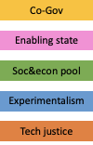
Transfer Journey Mapping - Measurement (Done in Meeting)
Phases/Time
What actions were made by this stakeholder?
What actions were made by this stakeholder?
What actions were made by this stakeholder?
Stakeholders
Public
4
High
Indicators
Moderate
Weak
Notes:
This will be completed during the actual meeting.

Slide 20
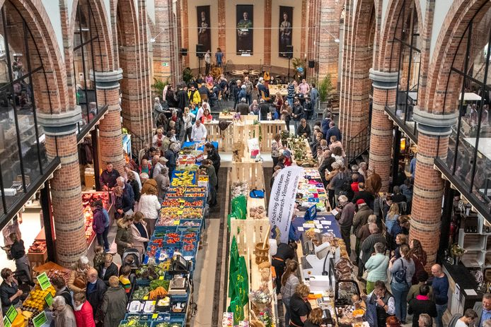
Transfer Journey Mapping - End Point (template)
In the spaces below, please provide images of your ENDING asset(s) along with a short description (ex. Type of building, etc.).
Assets
PLACE PICTURE(S) OF YOUR ASSETS HERE
PLACE PICTURE(S) OF YOUR ASSETS HERE
Ready with open call for a lively St-Jozef church… for and from the neighbourhood
Better cooperation between city services & commons (with new methodology for open call etc)

Slide 21
Transfer Journey Mapping - End Point (template)
Change
During the meeting, reflect on the 4 challenges you described in Slide 5. How did you meet these challenges? Describe your successful strategies.
Challenge #1:
Challenge #2:
Challenge #3:
Challenge #4:
Better collaboration between city services by the LAWG
Long-term focus through the creation of a catalog and a written methodology for the approach of e.g. open call.
Better support citizens' initiatives by launching an incubator = a point where starting initiatives receive legal and administrative support
Expected social impact explicitly described in agreements
clear description of the mutual expectation can ensure a higher level of openness. Inclusiveness: looking for ways to create more inclusiveness . E.g. drawning citizen panel for neighbourhood-budget

Slide 22
Transfer Journey Mapping - Ending Point (Template)
Policy Changes
During the meeting in the boxes below, please write a short description of how your policy changed throughout the journey in terms of Commons and Citizen Participation.
There is growing awareness of the need to support citizens' initiatives. It started with installing funds and making regulations. Now there is also a willingness to use civil servants to support the initiatives in submitting applications, drawing up agreements, etc. For example the launching of an incubator to support citizen initiatives. We are trying to develop a higher level vision of city-wide participation.
Commons?
Type an ‘X’ to indicate Yes or No
YES
X
By talking and discussing a lot together, a good basis is created for further cooperation.
Any decision concerning commons is now also discussed WITH commons. There is more trust instead of mistrust.
NO
-
Citizen participation?
Type an ‘X’ to indicate Yes or No
YES
X
Ghent has always paid a great deal of attention to civic participation, but this was mainly from the policy participation department. We have noticed that, over time, other services are also making the reflex to involve citizens quicker. This is certainly also the merit of Civic eState, which gave us room to involve other services.
NO
-

Slide 23
Transfer Journey Mapping - Ending Point (Template)
ULG
Changes
During the meeting in the box below, please briefly describe how the ULG was structured toward the end. Include references to the 5 types of stakeholders involved.
In the end we structured our ULG...
as an open forum for commons, where the commons decide which topics are discussed. The civil servants facilitate, bring in experts, support, but do NOT lead the whole thing.
Our ending ULG involved stakeholders in the following ways:
Public:
Private:
Knowledge/Institutions
Social Organizations:
Commoners/Civic/Innovators:
Highly involved
Be involved on request
Be involved on request
involved
Highly involved.

Slide 24
Transfer Journey Mapping - Ending Point (Template)
During the meeting in the box below, please briefly evaluate the success of your objectives described in Slide 11 for the project.
Mature
Objectives
Objective #1:
Objective #2:
Objective #3:
Objective #4:
multidisciplinary team of civil servants advised by commons (= LAWG)
Having a catalog and a written methodology for the approach of e.g. open call.
Having an incubator to support starting initiatives.
Having a list of parameters to measure social impact - to use in our agreements
all the initiatives we support as a city are open, tolerant, and as inclusive as possible…

Slide 25
Transfer Journey Mapping - End Point (template)
During the meeting, reflect on the 5 indicators and their development through the project.
-What changed and why did they change?
-What do you think of your ending point?
Evaluation
Regarding the 5 indicators, our transfer journey developed in the following ways:
Indicator | How did this indicator develop? Why? | Weak, Moderate, or Strong?
Co-Gov | this is more clearly structured, there are known points of contact and good cooperation | STRONG
Enabling State | The State plays a facilitating role, we support the actions of the commons, but do not decide on them. | STRONG
Soc&econ pool | Working on it, but nog finished yet | MODERATE
Experimentalism | we dare to make space for experimentation. Our commons do it, but the city itself also dares to be innovative in its rules and regulations. | STRONG
Tech justice | Certainly thanks to covid, we have made great leaps forward here, but we cannot say that we are already reaching everyone by digital way; a number of basic conditions (e.g. everyone has access to a digital device) have not been met. | MODERATE
Thanks to civic estate, we have been able to take good steps forward. The process gave us time to think carefully about where we can still make progress.
We certainly want to continue on the path we have taken, even after the completion of the project.

